Slide 1

Beluga Behavior Activity at exhibit

Slide 2

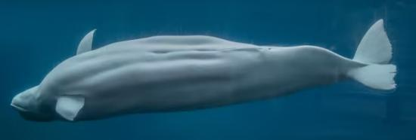
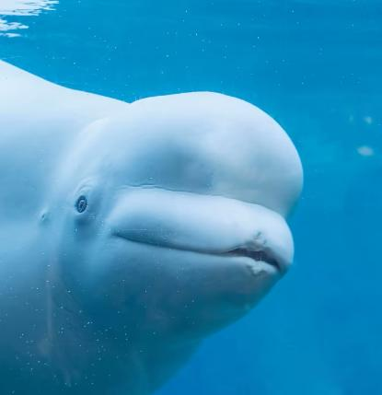
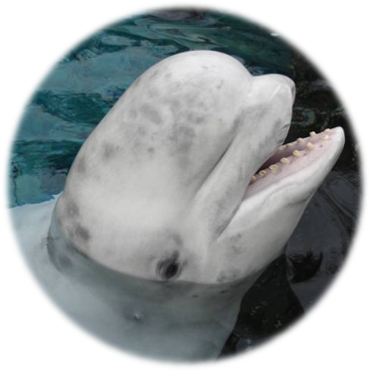
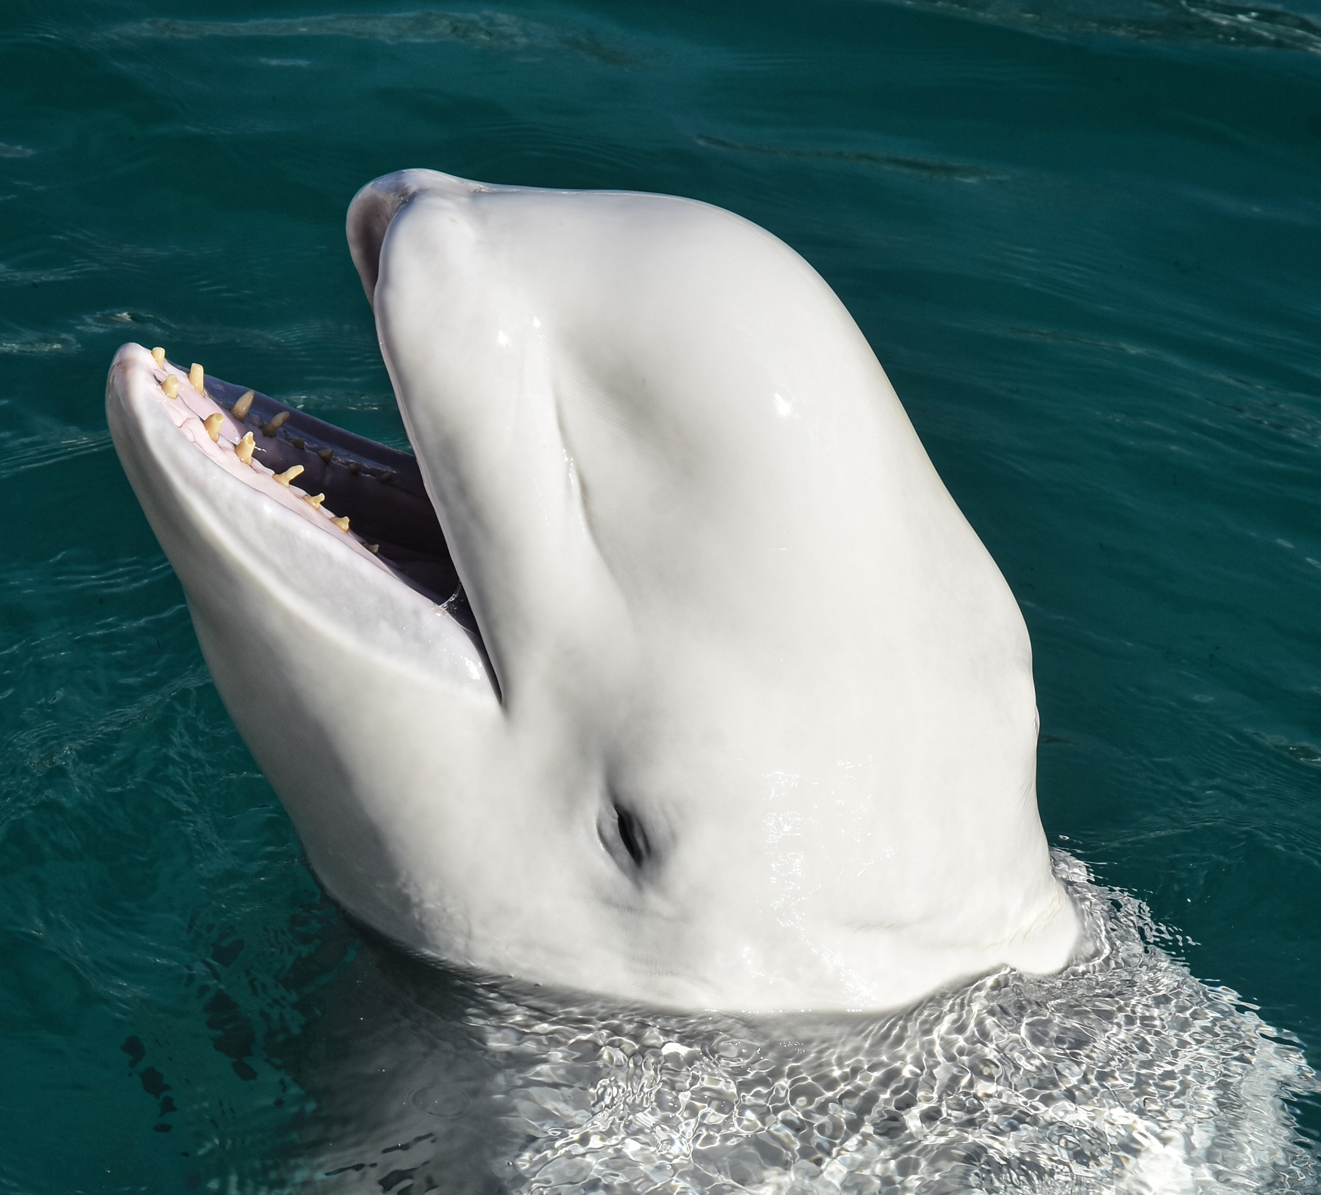
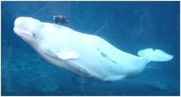
Juno
Kela
Male
Born in 2002
White with a dark gray stripe on back
Melon (forehead) is white.
Largest whale on habitat
Natasha
Female
Born in 1981
About half the size of Juno
White with many gray spots and marks all over
Female
Born in 1981
About half the size of Juno
All white with a small melon

Slide 3
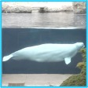
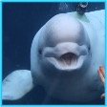
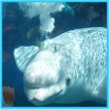
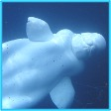
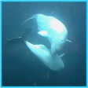

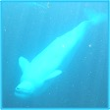
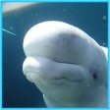
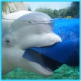
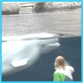
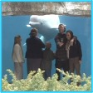
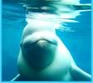
Beluga Whale Behaviors
Standard Swim
Swimming forward in a normal, belly-down position
Jaw Pop
The whale opens its mouth. Usually when interacting with guests or with another whale
Bubbles
A burst of bubbles comes up from the whale’s blowhole
Side Swim
Swimming forward with the belly facing to the side
Mouthing
One whale appears to playfully “bite” another whale
Logging
The beluga is resting at the surface of the water
Upside-Down
Swimming forward with the belly facing upward
Head Bob
The head is rapidly shaken up and down, cuing the melon (forehead) to wiggle
Enrichment
Playtime! Looks like the trainers have given the whales a toy to play with
Surface
The animal’s blowhole breaks the water’s surface and takes a breath. You may see and hear a puff of air
Audience
Somebody came to visit with guests at the underwater viewing window
Hi!
Vocalization
Did you hear something? Belugas can use their blowhole to make over 200 different sounds.

